Slide 1
__________________________________________________________ Antibiotics for lower Respiratory Tract Infection in Children presenting in Primary Care
ARTIC PC
Site Initiation Meeting
GP Practice

Slide 2
Funding, Sponsorship & Management
Funding – NIHR HTA Programme 13 34 64
Sponsor – University of Southampton
Ethics – Approved by SW Central Bristol Research Ethics Committee
Study Management:
Chief Investigator: Professor Paul Little & Professor Theo Verheij
Clinical Project Manager: Dr Gilly O’Reilly
Clinical Trial Coordinator: Natalie Thompson

Slide 3
Background
Acute respiratory tract infections in children are commonly managed in Primary Care
There is a lack of evidence to support GP’s in targeting antibiotics in children with no evidence for different subgroups
Antibiotic resistance is increasing
Antibiotic use is increasing
Need for a large study to examine the cost & effectiveness of antibiotic prescribing in children & to improve our quality of care for children by providing evidence based practice
This is a randomised placebo controlled parallel group trial of amoxicillin or placebo for children with chest infections
The trial is nested within an observational study

Slide 4
Aims & Objectives
The aim of the ARTIC PC study is to provide evidence to inform the management of chest infections in children
The objectives of the ARTIC PC Study are to estimate:
Effectiveness of amoxicillin in children presenting with uncomplicated LRTI
Cost effectiveness of antibiotics
Effectiveness according to key pathophysiological subgroups (provisionally Sputum seen and/or heard by parents (’rattly chest’) or by clinician on clinical examination, History of fever, Physician rating of being unwell, Chest signs (non-focal coarse crepitation's/rhonchi/wheeze))

Slide 5
Project overview
Based on an adult project with very similar data collection called GRACE
To commence Autumn 2016 for three years
Aim to recruit 938 children + (to the trial only, the observational recruits are additional to this)
Includes practices supported by the Universities of Southampton, Cardiff and Bristol

Slide 6
What is Involved for the Surgery
Child > 6 months & less than 13 years presents with LRTI
Observational & Trial study are both explained & PIS provided
If patient/carer are interested consent is obtained for either the observational study or the Drug trial (Placebo or Amoxicillin)
Patient is screened for eligibility*
Patients consenting into the Drug Trial are randomised into either the Amoxicillin or the Placebo group.
CRF 1 is completed (online or paper)
Throat swab (optional)
Explain diary to the parent/guardian & advise regarding storage of study medication, provide patient bag & present certificate and sticker
An appointment is made for 28days
*although the overall clinical assessment of suitability for the study, and including clinical examination (to detect a pneumonia for the trial arms) must be done by a doctor or a nurse practitioner but all the other elements in the CRF (items of history etc) and consent can be done by a trained research nurse or trained HCA in order to save consultation time of doctors and nurse practitioners.

Slide 7
What is involved at the 28day follow up visit?
Collect any unused study medication & estimate use
Collect patient diary (if not returned)
Peak Flow Expiratory Rate (6years+ only)

Slide 8
Eligibility Criteria
Inclusion Criteria:
Age 6m -12y
Presenting with infective acute LRTI
Exclusion criteria :
Non-Infective cough (including non-infective asthma exacerbation)
Immune compromised
Antibiotics in last 30 days

Slide 9
Additional exclusion criteria for trial only
Penicillin hypersensitivity
Hypersensitivity to any other beta lactam antibiotic
Jaundice/hepatic impairment due to amoxicillin
Medication known to interact with amoxicillin
Sibling enrolled in this project
Clinical diagnosis of pneumonia
Previously enrolled in ARTIC PC
Severe tachypnoea (clinician judged)
Known Infectious mononucleosis
Known phenylketonuria
Children enrolled in another medical trial in the past 3 months
Meeting the criteria for referral to hospital using the NICE Feverish children clinical guideline CG160 and NICE guideline on Sepsis in Children and Adults NG51

Slide 10
Practical tips
The eligibility is broad the main exclusion criteria to consider are:
Too ill/ Immune compromised/ Penicillin allergy/ Other CTIMP/ Non infective cough/ Abx in last 30 days.
Include a wide range as if only the sickest children get in to the project and we show that antibiotics help we will have done everyone a disservice since this will not help us target antibiotics or enable us to advise GPs not to prescribe in subgroups of children.
Low prescribers are really not much more evidence based than high prescribers in this area (since there is virtually no evidence from trials in children) and we need to see if the common group of children who are prescribed antibiotics benefit and who do not benefit.

Slide 11
Observational Study versus Drug Trial
Observational study
Drug Trial
Patients that are not suitable for enrolling in the trial (e.g. penicillin allergy) or refusing to consent into Trial can enter the observational study
Patients still have option swabs & spirometry
Weekly (Mon- Fri) temperature monitoring of IMP
Pharmacovigilance – delegated responsibility for signing out the IMP
SAE reporting in a timely fashion (on line preferred)

Slide 12
GCP for ARTIC PC
Only the parent or legal guardian can give consent for a child, the child can give assent
As Local Investigator (usually a GP) can delegate duties but NOT responsibility with oversight of safety
All staff involved need to understand the Protocol
All staff involved need to recognise the use of the ISF
Receive informed consent (and record in the medical notes)
Complete the CRF
Recognise when things have gone wrong and report them early e.g. Protocol breach, SAE

Slide 13
Completing the Informed Consent Form
Make sure parent (or legal guardian) initials boxes appropriately & signs and dates at the bottom of the page. Person taking consent must also sign & date the form. 1 copy to each of the following;
    Patient
    ARTIC PC team
    Patients notes
    Site file
Take patient assent as/when appropriate only
Consent to contact carer (for the study team to contact them)
NB only those with parental or legal guardianship can consent for a child to take part in research unlike clinical care

Slide 14
Randomising patients
Recruiting clinician to dispense sequentially numbered pre-prepared randomised packs
Dispensing clinician will be blind to which group patients have been randomised to
Prepare the IMP – instructions and dosing information provided
Label the IMP (child’s name and dose) box and bottles, explain if not making up all 3 bottles (as based on weight if small will not need 3)
Unblinding Card with 24 hours unblinding service tel num – PT advised to keep on them

Slide 15
Completing the screening/baseline CRF 1
Option to complete via ARTIC PC online database
https://www.researchonline.org/
or to complete in paper first then transfer to ARTIC PC database
Includes:
  Inclusion/exclusion criteria
  Background information
  Symptom description
  Clinical examination (Temperature, HR, RR, O2 sats, Capillary refill)
  Medication advice

Slide 16
Throat swab
Check did the parent/legal guardian initial the box for the (optional) throat swab on the consent form?
Complete the swab requisition form in patient pack (remember to include the Patient Number) & send a copy to the study team (green top first and only purple top if consent to store)
Label the swabs (3 minimum e.g. DoB, first and last names)
Remember to complete the PID on the swab bottles (sticky labels provided)
Complete the ARTIC PC online database form
Complete the pathology throat swab requisition form in patient pack (remember to include the Patient Number) Send sample(s) to the right lab via the sealable pack provided

Slide 17
Practical tips
Remember to add 3 identifiers to the samples and requisition forms like any clinical sample plus the ARTIC PID
Remember to add your post code to the back of the box of swabs

Slide 18
Practical tips
Remember we can pay out of pocket expenses if necessary

Slide 19
Study medication
Medication to be titrated depending upon child’s weight as taken at the initial visit – Dosing table provided
A nurse or HCA can give the medication to a recruit although you may want a ‘counter signature’ on the drug accountability form (this does not need to be a GP or nurse prescriber)
Advice to parents/guardians:
  Medication to be stored in the fridge once it is made up
  Medication to be taken 3 times a day for 7 days
  They can also medicate with ibuprofen or paracetamol
  Seek medical assistance again of symptoms progress – normal safety netting advice

Slide 20
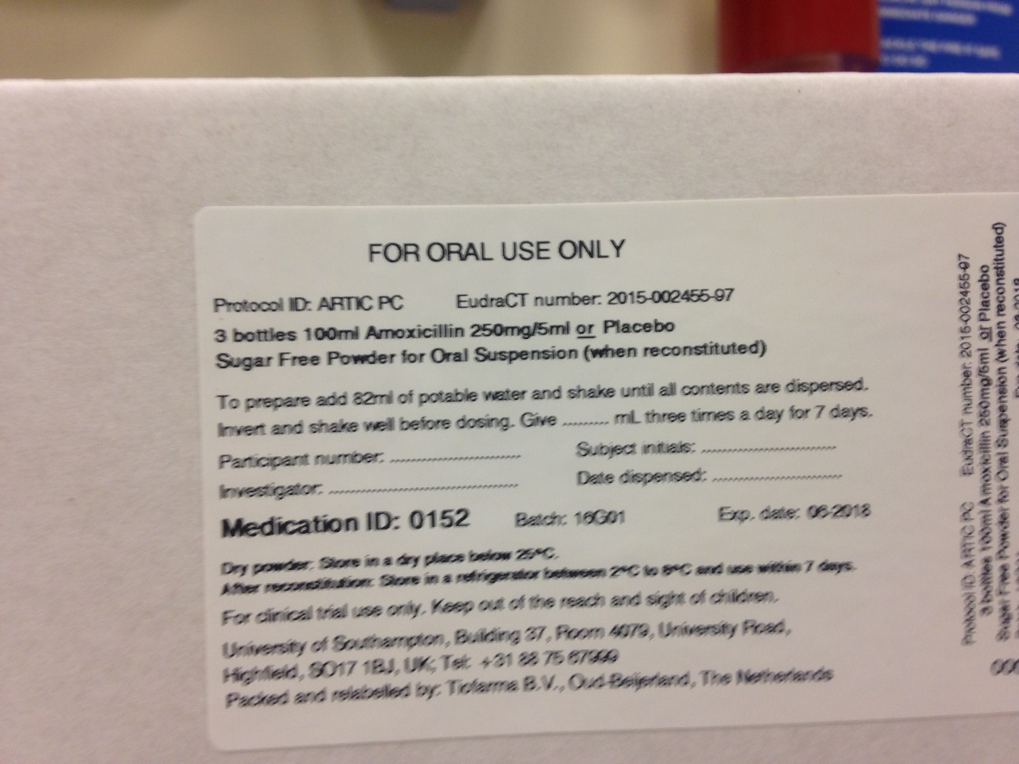
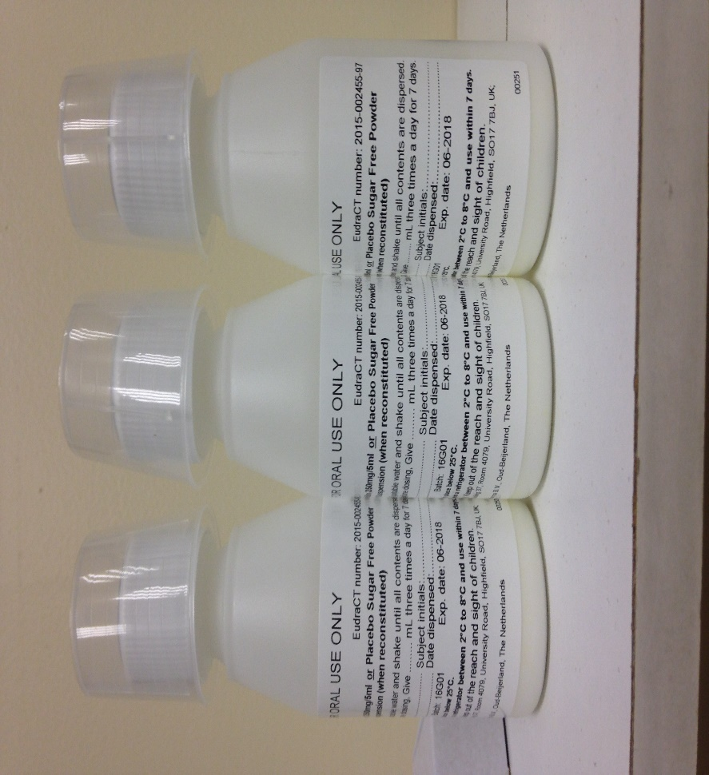
IMP
Add dose (blue), initials (yellow), PID (green) note MID (orange)
Add dose (blue), initials (yellow) note MID (orange)

Slide 21
What are you asking the patient/carer to do?
Initial appointment will take about 30-40minutes
Parents/ legal guardians are being asked to consent their child into either a Clinical Trial or an Observational study
If they consent to the Clinical Trial then they will be asked to take the study medication (either Amoxicillin or placebo) 3 times a day for 7 days
Patient/Carer are being asked to complete a diary of daily & weekly questions from the first day they see you for 4 weeks or more likely until their symptoms have resolved
Patient/Carer to return for a 28day follow up appointment & return their diary & any unused study medication. Children >6years will also be asked to complete a peak flow test

Slide 22
Models of working
Triage system & including reception/admin team
Double slots
Nurse: GP shuttling model
Time at the end of clinic
Recruit during research slots
If only 1 GP recruiting – sharing other workload with colleagues

Slide 23
SAE’s
SAE’s will be collected from the point of recruitment until day 28
SAE’s include :
  Anaphylaxis - severe allergy requiring steroid administration
  Emergency hospitalisation for chest problems
  Severe Clostridium requiring hospitalisation (antibiotic related diarrhoea)
  Must be reported within 24hours of becoming aware of the event
Entered onto online database – preferred
Or printed, signed as a true copy, & faxed to 023 8000 2380.
Remember to also document it in the patients medical records

Slide 24
Withdrawal/Early Discontinuation
Patients free to withdraw at any stage without giving a reason
This should not be confused with patients who stop their study medication early
Withdrawal form needs to be completed via the ARTIC PC database

Slide 25
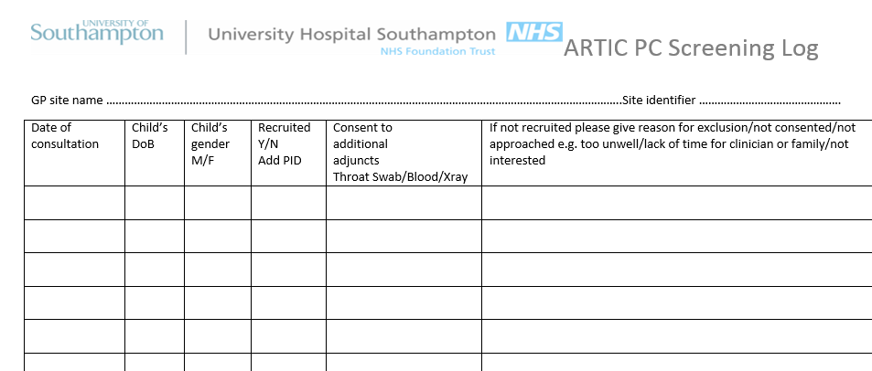
Screening log
Please remember to complete the screening log for all patients screened for the study (section 6.4 ISF)

Slide 26
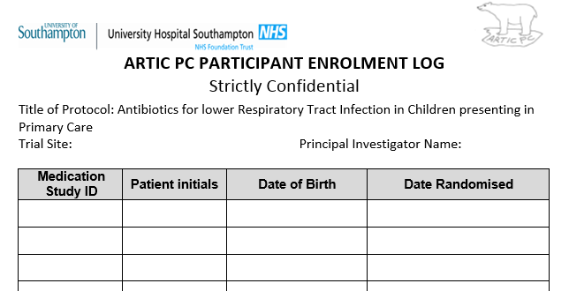
Participant Enrolment log
All patients enrolled into the ARTIC PC study should be included on the enrolment log (section 6.5)

Slide 27
Protocol Deviations
Examples include
  Wrong age
  Sibling enrolled
  Prior enrolment
Please inform the study team as soon as you are aware of any Protocol deviations

Slide 28
Practice payment
Task | Trial | Observational study | RC or SSC (per patient recruited)
Set up | £123.92 | £123.92 | RC TOTAL NOT PER RECRUIT
Screen/consent | £51.79 | £31.79 | SSC
Randomisation | £24.00 | £0.00 | RC
CRF completion | £26.40 | £26.40 | RC
Instruction for IMP | £2.20 | £0.00 | RC
Throat swabs | £4.39 | £4.39 | RC
Instruction on diary | £2.20 | £2.20 | RC
28 day reminder | £0.62 | £0.62 | RC
28 day spirometry | £3.73 | £3.73 | RC
28 day diary return | £3.73 | £3.73 | RC
Notes review | £5.49 on completion | £5.49 on completion | RC

Slide 29
Needed from you
CV signed and dated of Local Investigator (wet ink for your ISF)
ICH-GCP certificate from Local Investigator (dated within 2 years)
CV signed and dated by other team members (wet ink in your ISF)
Completed and signed site agreement
Confirmation of IMP storage risk assessment
HRA confirmation/capacity to undertake the study
Signatory log
Training log
Delegation log

Slide 30
We will provide
An Investigator Site File
All paperwork
Study participant packs – CRF, diary, medication, stickers & certificate for child
Swabs, mouth pieces for peak flow meters
A ‘Green light’ to recruit –DO NOT START TO RECRUIT UNTIL YOU RECEIVE GREEN LIGHT FROM US
A manual how to use the database http://www.researchonline.org/

Slide 31
ARTIC PC Contact Details
Professor Paul Little, Co-Chief Investigator
P.Little@soton.ac.uk
Professor Theo Verheij, Co Investigator
T.J.M.Verheij@umcutrecht.nl
Dr Gilly O’Reilly, Project Manager
gor@soton.ac.uk Tel:02380591785
Natalie Thompson, Local Study Coordinator
artic-pc@soton.ac.uk

